Slide 1
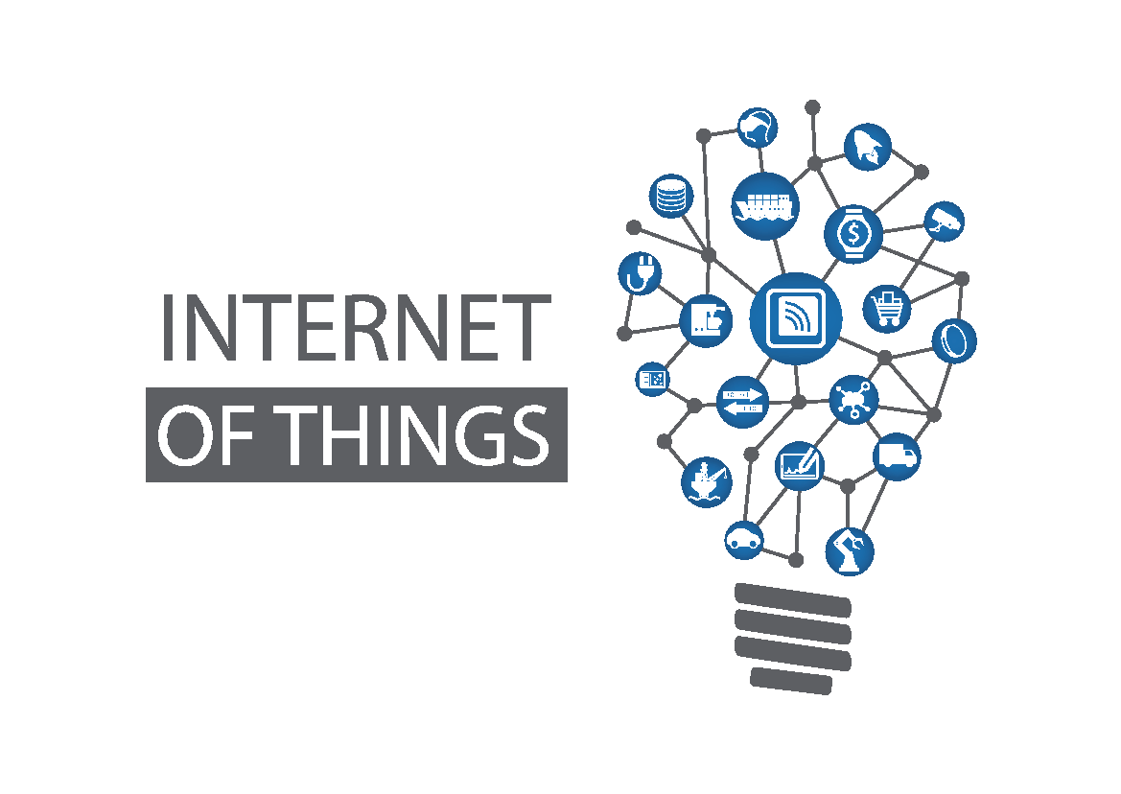
Unit-I Introduction
Ms. Kritika Purohit
Assistant Professor
Computer Science & Engineering

Slide 2
Points to be covered-
Introduction-
Definition of IoT
Characteristic of IoT
Applications of IoT
Design of IoT-
Physical Design-
IoT Protocols

Slide 3
Points to be covered-
Logical Design-
IoT Functional Block
IoT Communication Model
IoT Communication APIs
IoT Enabling Technologies
IoT Levels and Deployment Templets

Slide 4
Introduction
Definition-
Physical Object + Controller, Sensor, and Actuators + Internet = Internet of Things
The Internet of Things, or IoT is a system of Interrelated Computing devices, Mechanical and Digital machines, Objects, Animal or People that are provided with unique identifiers and the ability to transfer data over a network without requiring human-to-human or human-to-computer interactions.

Slide 5
Characteristics of IoT-
Dynamic and self-adapting -IoT devices and systems may have the capability to dynamically adapt with the changing contexts and take actions based on their operating conditions, User's content or sensed environment. Example the surveillance system is adapting itself based on context and changing conditions.
Self-configuring- Allowing many devices to work together to provide certain functionality.
Inter-operable communication protocols- Support several interoperable communication protocols and can communicate with other devices and with infrastructure.
Unique identity- Each IoT device has a unique identity and a unique identifier (IP addresses).
Integrated into information network- It allows them to communicate and exchange data with other devices and systems.

Slide 6
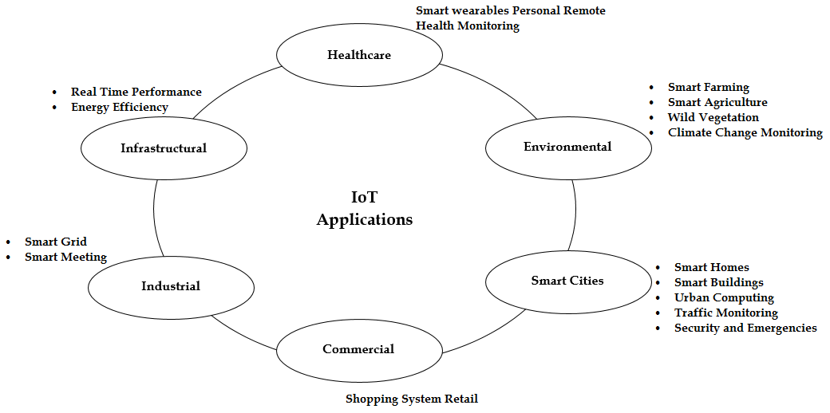
Application of IoT-

Slide 7
Design of IoT-
Physical Design- Physical design of IoT refers to IoT devices and IoT protocols.
Things – Things are the mode devices which have unique identities and can perform remote sensing, activating a monitoring capability. Things are main part of IoT applications. IoT devices can be of several types - sensing devices, smart watches, Smart electronic appliances, and wearable sensors, auto mobile and industrial machines.
These devices generate data in some form or the other which when processed by data analytics system leads to useful information to guide further actions locally or remotely.
IoT devices collect data from on board or attached sensors and sensed data communicated either to other device or cloud-based servers. These cloud-based servers are specially designed to analyse and process data.

Slide 8
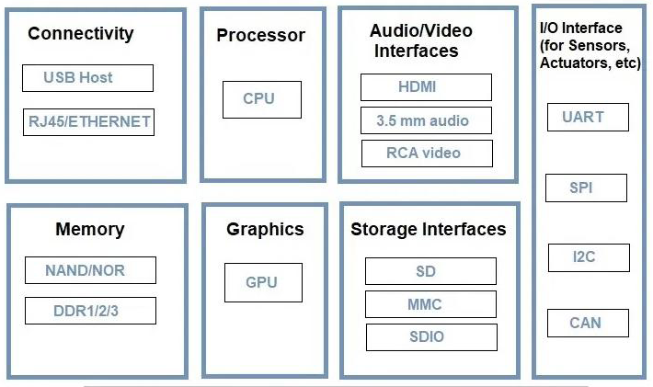
Generic Block Diagram of IoT

Slide 9
IoT Protocols- - IoT protocols help to establish communication between IoT devices (node devices) and over the cloud-based servers over the Internet. It helps to send commands to IoT device and receive data from an IoT device over the Internet.

Slide 10
Link Layer - Link layer protocols determine how data is physically sent over the network‘s physical layer or medium. Link Layer determines how the packets are coded and signalled by the hardware device over the medium to which the host is attached.
Link Layer Protocols-
802.3- Ethernet- Ethernet is a set of technologies and protocols that are used primarily in LANs.
802.11- WIFI- IEEE 802.11 is part of the IEEE 802 set of LANs protocols and specifies the set of media access control (MAC) and physical layer (PHY) protocols for implementing wireless local area network (WLAN).
802.16 – Wi-Max: The standard for Wi-MAX technology is a standard for Wireless Metropolitan Area Networks (WMANs) that has been developed by working group number 16 of IEEE 802, specializing in point-to-multipoint broadband wireless access.

Slide 11
802.15.4 -LR-WPAN: A collection of standards for Low-rate wireless personal area network. The IEEE ‘s 802.15.4 standard defines the MAC and PHY layer used. The standards provide low-cost and low-speed communication for power constrained devices.
2G/3G/4G- Mobile Communication: These are different types of telecommunication generations. IoT devices are based on these standards can communicate over the cellular networks.

Slide 12
Network Layer- Network Layer is responsible for sending of IP datagrams from the source network to the destination network. Network layer performs the host addressing and packet routing. We used IPv4 and IPv6 for Host identification. IPv4 and IPv6 are hierarchical IP addressing schemes.
Network Layer Protocol-
IPv4: An Internet Protocol address (IP address) is a numerical label assigned to each device connected to a computer network that uses the Internet Protocol for communication. An IP address serves two main functions: host or network interface identification and location addressing. Internet Protocol version 4 (IPv4) defines an IP address as a 32-bit number.

Slide 13
IPv6: Internet Protocol version 6 (IPv6) is the most recent version of the Internet Protocol (IP), the communications protocol that provides an identification and location system for computers on networks and routes traffic across the Internet. IPv6 was developed by the Internet Engineering Task Force (IETF) to deal with the long-anticipated problem of IPv4 address exhaustion.
6LoWPAN: 6LoWPAN is an acronym of IPv6 over Low-Power Wireless Personal Area Networks.6LoWPAN is the name of a concluded working group in the Internet area of the IETF. 6LoWPAN is a somewhat contorted acronym that combines the latest version of the Internet Protocol (IPv6) and Low-power Wireless Personal Area Networks (LoWPAN).

Slide 14
Transport Layer- This layer provides functions such as error control, segmentation, flow control and congestion control. So, this layer protocols provide end-to-end message transfer capability independent of the underlying network.
Transport Layer Protocols-
TCP: TCP (Transmission Control Protocol) is a standard that defines how to establish and maintain a network conversation through which application programs can exchange data. TCP works with the Internet Protocol (IP), which defines how computers send packets of data to each other. Together, TCP and IP are the basic rules defining the Internet.
UDP: User Datagram Protocol (UDP) is a Transport Layer protocol. UDP is a part of Internet Protocol suite, referred as UDP/IP suite. Unlike TCP, it is unreliable and connectionless protocol. So, there is no need to establish connection prior to data transfer.

Slide 15
Application Layer- Application layer protocols define how the applications interface with the lower layer protocols to send over network.
Application Layer Protocols-
HTTP: Hypertext Transfer Protocol (HTTP) is an application-layer protocol for transmitting hypermedia documents, such as HTML. It was designed for communication between web browsers and web servers, but it can also be used for other purposes.
CoAP: CoAP-Constrained Application Protocol is a specialized Internet Application Protocol for constrained devices, as defined in RFC 7252. It enables devices to communicate over the Internet. It is defined as Constrained Application Protocol, and is a protocol intended to be used in very simple hardware.

Slide 16
Web Socket: The Web Socket Protocol enables two-way communication between a client’s running untrusted code in a controlled environment to a remote host that has opted-in to communications from that code. The security model used for this is the origin-based security model commonly used by web browsers.
MQTT: MQTT is a machine-to-machine (M2M)/‖Internet of Things‖ connectivity protocol. It was designed as an extremely lightweight publish/subscribe messaging transport and useful for connections with remote locations where a small code footprint is required and/or network bandwidth is at a premium.
XMPP: Extensible Messaging and Presence Protocol (XMPP) is a communication protocol for message-oriented middleware based on XML (Extensible Mark-up Language). It enables the near-real-time exchange of structured yet extensible data between any two or more network entities.

Slide 17
DDS: The Data Distribution Service (DDS™) is a middleware protocol and API standard for data-centric connectivity from the Object Management Group® (OMG®). It integrates the components of a system together, providing low-latency data connectivity, extreme reliability, and a scalable architecture that business and mission-critical Internet of Things (IoT) applications need.
AMQP: The AMQP IoT protocols consist of a hard and fast of components that route and save messages within a broker carrier, with a set of policies for wiring the components together. AMQP has the following three additives, which might link into processing chains in the server to create the favoured capability.
Exchange
Message Queue, and
Binding

Slide 18
Logical Design of IoT- Logical design of IoT system refers to an abstract representation of the entities & processes without going into the low-level specifies of the implementation. For understanding Logical Design of IoT, we describe given below terms-
IoT Functional Blocks- an IoT system comprises of several functional blocks that provide the system the capabilities for identification, sensing, actuation, communication and management.

Slide 19
Functional blocks are:
Device: An IoT system comprises of devices that provide sensing, actuation, and monitoring and control functions.
Communication: Handles the communication for the IoT system.
Services: services for device monitoring, device control service, data publishing services and services for device discovery.
Management: This block provides various functions to govern the IoT system.
Security: this block secures the IoT system and by providing functions such as authentication, authorization, message and content integrity, and data security.
Application: This is an interface that the users can use to control and monitor various aspects of the IoT system. Application also allows users to view the system status and view or analyse the processed data.

Slide 20
IoT Communication Models- For Communication we have these following models-
Request-Response Model- Request-response model is communication model in which the client sends requests to the server and the server responds to the requests. When the server receives a request, it decides how to respond, fetches the data, retrieves resource representation, prepares the response, and then sends the response to the client. Request-response is a stateless communication model, and each request-response pair is independent of others.

Slide 21
Publish-Subscribe Model- Publish-Subscribe are a communication model that involves publishers, brokers and consumers. Publishers are the source of data. Publishers send the data to the topics which are managed by the broker. Publishers are not aware of the consumers. Consumers subscribe to the topics which are managed by the broker. When the broker receives data for a topic from the publisher, it sends the data to all the subscribed consumers.

Slide 22
Push-Pull Model- Push-Pull is a communication model in which the data producers push the data to queues and the consumers pull the data from the Queues. Producers do not need to be aware of the consumers. Queues help in decoupling the messaging between the Producers and Consumers. Queues also act as a buffer which helps in situations when there is a mismatch between the rate at which the producers push data and the rate at which the consumer pull data.

Slide 23
Exclusive Pair Model- Exclusive Pair is a bidirectional, fully duplex communication model that uses a persistent connection between the client and server. Connection is setup it remains open until the client sends a request to close the connection. Client and server can send messages to each other after connection setup. Exclusive pair is stateful communication model and the server is aware of all the open connections.

Slide 24
IoT Communication APIs- Generally we used Two APIs for IoT Communication. These IoT Communication APIs are:
REST based Communication APIs- Representational state transfer (REST) is a set of architectural principles by which you can design Web services the Web APIs that focus on system ‘s resources and how resource states are addressed and transferred. The rest architectural constraints are as follows:
Client-Server
Stateless
Cache-able
Layered System
Uniform Interface
Code on Demand

Slide 25
WebSocket based Communication APIs- WebSocket APIs allow bi-directional, full duplex communication between clients and servers. WebSocket APIs follow the exclusive pair communication model.

Slide 26
IoT Enabling Technologies
Wireless Sensor Network- A wireless sensor network contains many tiny sensor nodes that are densely deployed either inside the phenomenon to be sensed or very close to it. Sensor nodes consist of sensing, data processing, and communicating components.
The position of sensor nodes need not be engineered or predetermined. This allows random deployment in inaccessible terrain or disaster relief operations.

Slide 27
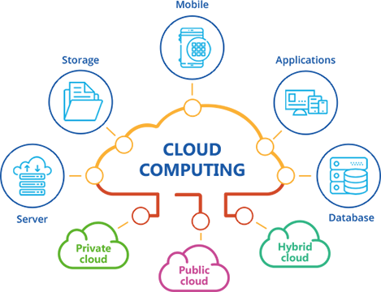
Cloud Computing- Cloud computing and its three service models of Software as a Service (SaaS), Platform as a Service (PaaS) and Infrastructure as a Service (IaaS) – are important to the IoT because it allows any user with a browser and an Internet connection to transform smart object data into actionable intelligence. Cloud computing provides “The virtual infrastructure for utility computing integrating applications, monitoring devices, storage devices, analytics tools, visualization platforms, and client delivery to enable businesses and users to access IoT-enabled applications on demand anytime, anyplace and anywhere.”

Slide 28
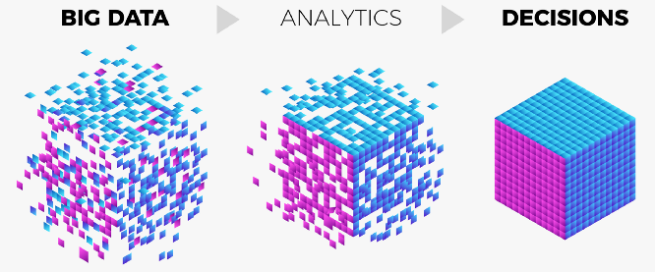
Big Data Analytics- Smart objects are connected to the IoT, more data is collected from them in order to perform analytics to determine trends and associations that lead to insights.
The term ―big data refers to these large data sets that need to be collected, stored, queried, analysed and generally managed in order to deliver on the promise of the IoT.
Further compounding the technical challenges of big data is the fact that IoT systems must deal with not only the data collected from smart objects, but also ancillary data that is needed to properly perform such analytics.

Slide 29
Communication Protocols- With respect to sending and receiving data, wired and wireless communication technologies have also improved such that nearly every type of electronic equipment can provide data connectivity. This has allowed the ever-shrinking sensors embedded in smart objects to send and receive data over the cloud for collection, storage and eventual analysis.
Embedded Systems- Embedded systems are part and parcel of every modern electronic component. These are low power consumption units that are used to run specific tasks for example remote controls, washing machines, microwave ovens, RFID tags , sensors, actuators and thermostats used in various applications, networking hardware such as switches, routers, modems, mobile phones, PDAs, etc. Usually embedded devices are a part of a larger device where they perform specific task of the device.

Slide 30
IoT Levels and Deployment Templets
IoT Level 1- IOT system consists of a single node/ device that performs sensing or actuations, stores data, analyses it and hosts the application. IoT systems are suitable for modelling low- cost and low-complexity solutions where the data involved is not big and the analysis requirements are not computationally intensive.

Slide 31
IoT Level 2- A level-2 IoT system has a single node that performs sensing and/or actuation and local analysis. Data is stored in the cloud and application is usually cloud- based. IoT systems are suitable for solutions where the data involved is big, however, the primary analysis requirement is not computationally intensive and can be done locally itself.

Slide 32
IoT Level 3- IoT system has a single node. Data is stored and analysed in the cloud and application is cloud- based. IoT systems are suitable for solutions where the data involved is big and the analysis requirements are computationally intensive.

Slide 33
IoT Level 4- A level-4 IoT system has multiple nodes that perform local analysis. Data is stored in the cloud and application is cloud-based. Level-4 contains local and cloud- based observer nodes which can subscribe to and receive information collected in the cloud from IoT devices. Level-4 IoT systems are suitable for solutions where multiple nodes are required, the data involved is big and the analysis requirements are computationally intensive.

Slide 34
IoT Level 5- A level-5 IoT system has multiple end nodes and one coordinator node. The end nodes that perform sensing and/or actuation. Coordinator node collects data from the end nodes and sends to the cloud. Data is stored and analysed in the cloud and application is cloud-based. Level-5 IoT systems are suitable for solutions based on wireless sensor networks, in which the data involved is big and the analysis requirements are computationally intensive.

Slide 35
IoT Level 6- level-6 IoT system has multiple independent end nodes that perform sensing and/or actuation and send data to the cloud. Data is stored in the cloud and application is cloud-based. The analytics component analyses the data and stores the results in the cloud database. The results are visualized with the cloud-based application. The centralized controller is aware of the status of all the end nodes and sends control commands to the nodes.

Slide 36
Queries ??

